Slide 1
Number System Conversion Using Stack Data Structure in C

Slide 2
Objective:
The objective of this project is to develop a menu-driven C program that performs conversion between different number systems (Binary, Octal, Decimal, and Hexadecimal) using the Stack data structure. The project aims to demonstrate the practical application of stacks in solving real-world problems, particularly in the area of data representation and conversion in computer systems.

Slide 3
Problem Statement:
In computer science, different number systems are used for various purposes, such as binary for machine-level operations, octal/hexadecimal for compact representation, and decimal for human interaction. Manually converting between these systems is time-consuming and prone to calculation errors.
The problem is to automate these conversions in a way that:
Is fast and accurate.
Can handle large numbers without manual calculation.
Supports both integer and alphanumeric inputs (for hexadecimal).
Demonstrates the LIFO (Last-In-First-Out) principle of stacks in a practical context.

Slide 4
Scope:
Decimal → Binary, Octal, Hexadecimal
Binary → Decimal
Octal → Decimal
Hexadecimal → Decimal
Input handling for both numeric and string-based numbers.
Stack implementation for reversing digits during conversion.

Slide 5
Data Structure Used:
Stack – Implemented using arrays in C.
The stack is used to store intermediate remainders or positional values during number system conversion.
Follows the LIFO (Last-In-First-Out) principle to reverse the order of digits for correct output.
Programming Language Used:
C Language
Chosen for its low-level memory control, fast execution, and simplicity in demonstrating core data structure concepts.
Uses standard libraries like:
<stdio.h> – for input/output operations.
<string.h> – for string length operations in conversions.
<math.h> – for power calculations during base-to-decimal conversions.

Slide 6
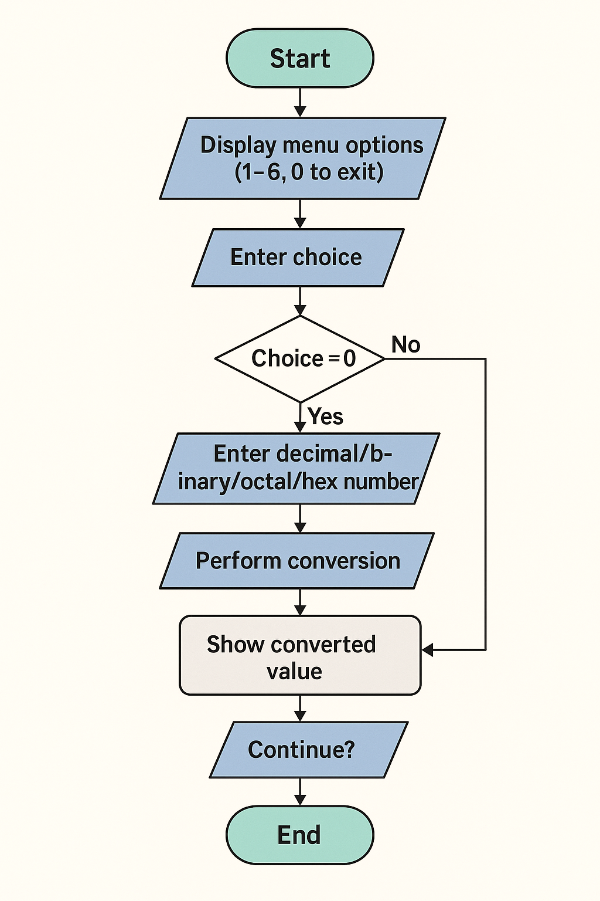
FLOWCHART:

Slide 7
Operations Involved in the Project:
Push Operation
Inserts an element (digit or value) onto the stack during conversion.
Pop Operation
Removes the top element from the stack to retrieve digits in correct order.
Check if Stack is Full (isFull)
Verifies if the stack has reached its maximum capacity before inserting a new element.
Check if Stack is Empty (isEmpty)
Verifies if the stack has no elements before popping.
Decimal to Binary Conversion
Converts a decimal number to its binary representation using repeated division and stack storage.
Decimal to Octal Conversion
Converts a decimal number to octal format.
Decimal to Hexadecimal Conversion
Converts a decimal number to hexadecimal format, including letter digits (A–F).
Binary to Decimal Conversion
Converts a binary number (string input) into decimal using positional values.
Octal to Decimal Conversion
Converts an octal number to decimal.
Hexadecimal to Decimal Conversion
Converts a hexadecimal number (string input with digits and letters) to decimal.
Menu-Driven Execution
Displays a menu of available conversions and executes the chosen operation.
Invalid Input Handling
Detects and displays an error message for invalid base digits.

Slide 8
Operation: Number Conversion Tool
Implementation Methodology:
Use arrays, stack implementation, and functions to convert numbers between different bases (Decimal, Binary, Octal, Hexadecimal). The program takes user input at runtime, processes it using push/pop stack operations, and displays the converted value.
Variable | Data Type / Structure
numstack | int array
MAXSIZE | int
top | int
number | int
base | int
choice | int
digit | int
strnum | char array
Variable | Data Type / Structure
value | int
i, j | int
isfull() | Function returning int
isempty() | Function returning int
push() | Function returning void
pop() | Function returning int
numberConversion1() | Function returning void
numberConversion2() | Function returning void

Slide 9
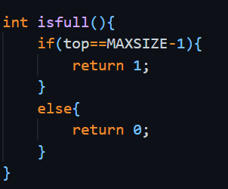
Operation: isfull()
Details:
Tests whether the stack array (numstack) is full to prevent overflow. Implementation methodology:
Compare global top with MAXSIZE - 1. Returns 1 if full, else 0. Algorithm (steps):
Read global top.
If top == MAXSIZE - 1 → return 1 (stack full).
Else → return 0 (not full). Time complexity: O(1)

Slide 10
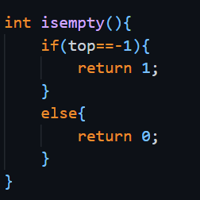
Operation: isempty()
Details:
Tests whether the stack is empty to prevent underflow. Implementation methodology:
Checks if top equals -1. Returns 1 if empty, else 0. Algorithm (steps):
Read global top.
If top == -1 → return 1 (stack empty).
Else → return 0 (not empty). Time complexity: O(1)

Slide 11
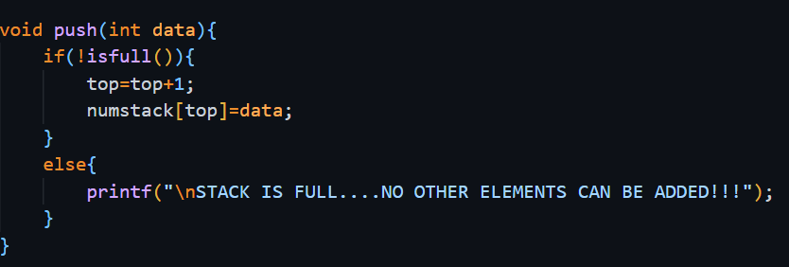
Operation: push(int data)
Details:
Pushes an integer data onto numstack (used to store remainders or partial values). Implementation methodology:
Calls isfull(); if not full, increments top then stores numstack[top]=data. If full, prints an overflow message. Void function (no status returned). Algorithm (steps):
Call isfull().
If it returns 1 → print overflow message and return.
Else → do top = top + 1.
Store numstack[top] = data.
Return. Time complexity: O(1)

Slide 12
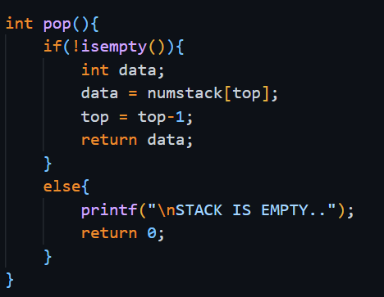
Operation: pop()
Details:
Pops and returns the top integer from numstack. Implementation methodology:
Calls isempty(); if not empty, reads numstack[top], decrements top, returns the value. If empty, prints a message and returns 0. Algorithm (steps):
Call isempty().
If it returns 1 → print underflow message and return 0.
Else → data = numstack[top].
top = top - 1.
return data.
Time complexity: O(1)

Slide 13
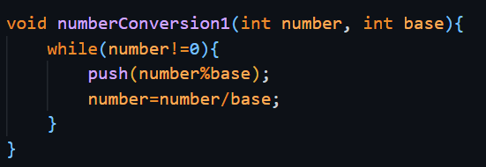
Operation: numberConversion1
Details:
Converts an integer number (decimal) into digits of base by repeated division; pushes remainders onto the stack.
Implementation methodology:
While number != 0, compute number % base and push(remainder); then number = number / base. Does not handle number == 0 or negative numbers explicitly inside this function.
Algorithm (steps):
Input: integer number, integer base.
While number != 0: a. remainder = number % base. b. push(remainder). c. number = number / base.
Return to caller (caller pops and prints digits).
Time complexity:
O(k) where k = number of digits in the target base.

Slide 14
Operation: numberConversion2
Details:
Converts a string number representing digits in base into decimal by iterating the string right-to-left, computing each digit value, computing value*pow(base,i) and pushing that product to stack. Your main sums popped values to get decimal result. Accepts 0-9, A-F, a-f. Prints "Invalid Input!!" and returns if a character is invalid.
Implementation methodology:
Iterate j from strlen(number)-1 down to 0.
For each character derive value (0–15).
Compute value * pow(base, i) and push(...).
Increment i (power index). Caller later pops all pushed products and sums them to get decimal.

Slide 15
Algorithm (steps):
Let i = 0.
For j = strlen(number)-1 down to 0: a. If number[j] in '0'..'9' → value = number[j] - '0'. b. Else if 'A'..'F' → value = number[j] - 'A' + 10. c. Else if 'a'..'f' → value = number[j] - 'a' + 10. d. Else → print "Invalid Input!!" and return. e. Compute term = value * pow(base, i). f. push(term). g. i = i + 1.
Return to caller (caller pops and sums all pushed term values to form decimal result).
Time complexity:
O(n) where n = number of digits in input string.

Slide 16
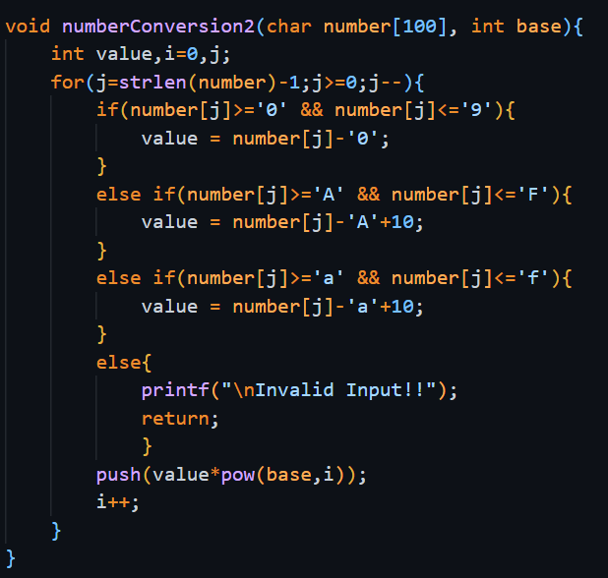

Slide 17
Operation: main() (menu-driven execution)
Details:
Presents a menu, reads user choice, resets top=-1 at the start of each loop, calls the appropriate conversion function, and prints results. Handles 6 conversion choices + exit. Uses scanf for inputs. For decimal→base it calls numberConversion1(...) then pops to print digits; for base→decimal it calls numberConversion2(...) then pops all pushed place-values and sums them to print decimal. Implementation methodology:
Infinite while(1) loop; inside, set top = -1 to reset stack for new operation.
Display menu, scanf("%d", &choice).
switch(choice) to dispatch:
Cases 1–3: prompt for decimal number, call numberConversion1(number, base), then while not isempty() pop digits and print (mapping >=10 to 'A'..'F').
Cases 4–6: prompt for string strnum, call numberConversion2(strnum, base), then pop all terms, accumulate into digit and print digit.
Case 0: exit.

Slide 18
Algorithm (main loop steps):
Loop start: top = -1.
Display menu and read choice.
If choice == 0 → print exit message and break.
switch(choice):
If decimal→base (1/2/3): a. Read integer number. b. Call numberConversion1(number, target_base). c. Initialize accumulator/display. While !isempty(): pop() and print digits (convert 10→'A', etc.).
If base→decimal (4/5/6): a. Read string strnum. b. Call numberConversion2(strnum, target_base). c. digit = 0. While !isempty(): digit += pop(). Print digit.
Default: print "NO SUCH CHOICE FOUND".

Slide 19
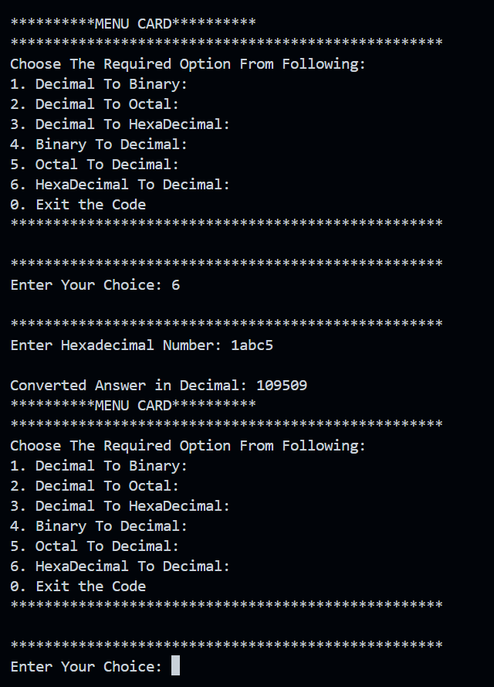

Slide 20
FINAL WORKING CODE:
#include<stdio.h>
#include<string.h>
#include<math.h>
int numstack[100];
int MAXSIZE = 100;
int top = -1;
int isfull(){
if(top==MAXSIZE-1){
return 1;
}
else{
return 0;
}
}
int isempty(){
if(top==-1){
return 1;
}
else{
return 0;
}
}

Slide 21
FINAL WORKING CODE:
void push(int data){
if(!isfull()){
top=top+1;
numstack[top]=data;
}
else{
printf("\nSTACK IS FULL....NO
OTHER ELEMENTS CAN BE ADDED!!!");
}
}
int pop(){
if(!isempty()){
int data;
data = numstack[top];
top = top-1;
return data;
}
printf("\nSTACK IS EMPTY..");
return 0;
}
}
void numberConversion1(int number, int base){
while(number!=0){
push(number%base);
number=number/base;
}
}

Slide 22
FINAL WORKING CODE:
void numberConversion2(char number[100], int base){
int value,i=0,j;
for(j=strlen(number)-1;j>=0;j--){
if(number[j]>='0' && number[j]<='9'){
value = number[j]-'0';
}
else if(number[j]>='A' && number[j]<='F'){
value = number[j]-'A'+10;
}
else if(number[j]>='a' && number[j]<='f'){
value = number[j]-'a'+10;
}
else{
printf("\nInvalid Input!!");
return;
}
push(value*pow(base,i));
i++;
}
}

Slide 23
FINAL WORKING CODE:
int main(){
int base,choice,number,digit=0,i;
char strnum[100];
while(1){
top=-1;
printf("\n**********MENU CARD**********\n");
for(i=0;i<=50;i++){
printf("*");
}
printf("\nChoose The Required Option From Following: ");
printf("\n1. Decimal To Binary: ");
printf("\n2. Decimal To Octal: ");
printf("\n3. Decimal To HexaDecimal: ");
printf("\n4. Binary To Decimal: ");
printf("\n5. Octal To Decimal: ");
printf("\n6. HexaDecimal To Decimal: ");
printf("\n0. Exit the Code");
printf("\n");

Slide 24
FINAL WORKING CODE:
for(i=0;i<=50;i++){
printf("*");
}
printf("\n");
printf("\n");
for(i=0;i<=50;i++){
printf("*");
}
printf("\nEnter Your Choice: ");
scanf("%d",&choice);
printf("\n");
for(i=0;i<=50;i++){
printf("*");
}
if(choice == 0){
printf("\nExiting the Program... GoodBye!!");
break;
}
switch(choice){
case 1:
printf("\nEnter Decimal Number: ");
scanf("%d",&number);
numberConversion1(number,base=2);
printf("\nConverted Answer in Binary: ");
digit=0;
while(!isempty()){
digit = pop();
if(digit>=10){
digit = 'A'+(digit-10);
printf("%c",digit);
}
else{
printf("%d",digit);
}
}
break;

Slide 25
FINAL WORKING CODE:
case 2:
printf("\nEnter Decimal Number: ");
numberConversion1(number,base=8);
printf("\nConverted Answer in Octal: ");
digit=0;
while(!isempty()){
digit = pop();
if(digit>=10){
digit = 'A'+(digit-10);
printf("%c",digit);
}
else{
printf("%d",digit);
}
}
break;
case 3:
printf("\nEnter Decimal Number: ");
scanf("%d",&number);
numberConversion1(number,base=16);
printf("\nConverted Answer in HexaDecimal: ");
digit=0;
while(!isempty()){
digit = pop();
if(digit>=10){
digit = 'A'+(digit-10);
printf("%c",digit);
}
else{
printf("%d",digit);
}
}
break;

Slide 26
FINAL WORKING CODE:
case 4:
printf("\nEnter Binary Number: ");
scanf("%s",strnum);
numberConversion2(strnum,base=2);
printf("\nConverted Answer in Decimal: ");
digit=0;
while(!isempty()){
digit = digit + pop();
}
printf("%d",digit);
break;
case 5:
printf("\nEnter Octal Number: ");
scanf("%s",strnum);
numberConversion2(strnum,base=8);
printf("\nConverted Answer in Decimal: ");
digit=0;
while(!isempty()){
digit = digit + pop();
}
printf("%d",digit);
break;

Slide 27
FINAL WORKING CODE:
case 6:
printf("\nEnter Hexadecimal Number: ");
scanf("%s",strnum);
numberConversion2(strnum,base=16);
printf("\nConverted Answer in Decimal: ");
digit=0;
while(!isempty()){
digit = digit + pop();
}
printf("%d",digit);
break;
default:
printf("\n**NO SUCH CHOICE FOUND**");
}
}
}

Slide 28
Thank you
Prakhar Tagra
CSE 2nd Year
Roll No. 2400270100127
Academic Session: 2025-26
Mentor: Mr. Vivek Agarwal

